Slide 1
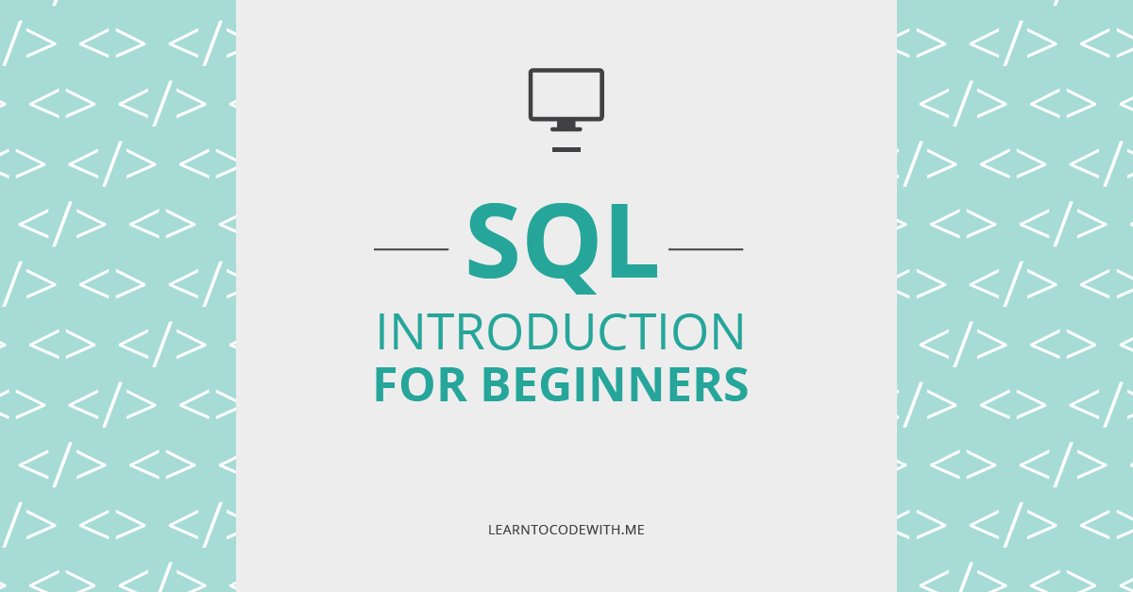

Slide 2
Contents Covered
Introduction of Database and SQL
Classification of SQL -Bhanu
DQL, DDL, DML -Chandu
TCL, DCL, Aggregate Functions -Akhil
Group By, Order By and Having -Sai
Joins and Conclusion -Vasthav

Slide 3
What is a database
Database is a organized collection of data. For example a database of a college would be having a collection of data such as – 1. Personal records of Students 2. Students performance history 3. Teachers data 4. Financial department data etc.
What is a database
Database is a organized collection of data. For example a database of a college would be having a collection of data such as – 1. Personal records of Students 2. Students performance history 3. Teachers data 4. Financial department data etc.

Slide 4
What is a database
Database is a organized collection of data. For example a database of a college would be having a collection of data such as – 1. Personal records of Students 2. Students performance history 3. Teachers data 4. Financial department data etc.
Database Management System (DBMS)
A database management system is a software application which is used for managing different databases. It helps us to create and manage database. With the help of DBMS we take care following tasks – 1. Data Security 2. Data Backup 3. Manages huge amount of data 4. Data export & import 5. Serving multiple concurrent database requests 6. Gives us a way to manage the data using programming languages.

Slide 5
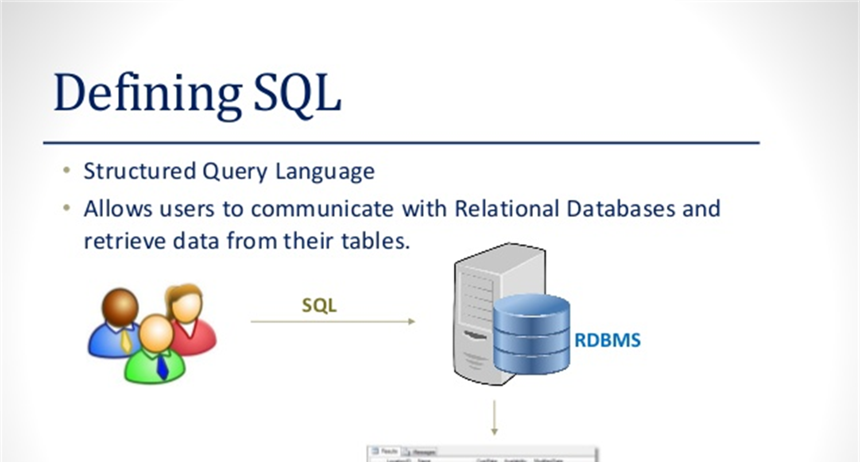
What is a database
Database is a organized collection of data. For example a database of a college would be having a collection of data such as – 1. Personal records of Students 2. Students performance history 3. Teachers data 4. Financial department data etc.

Slide 6
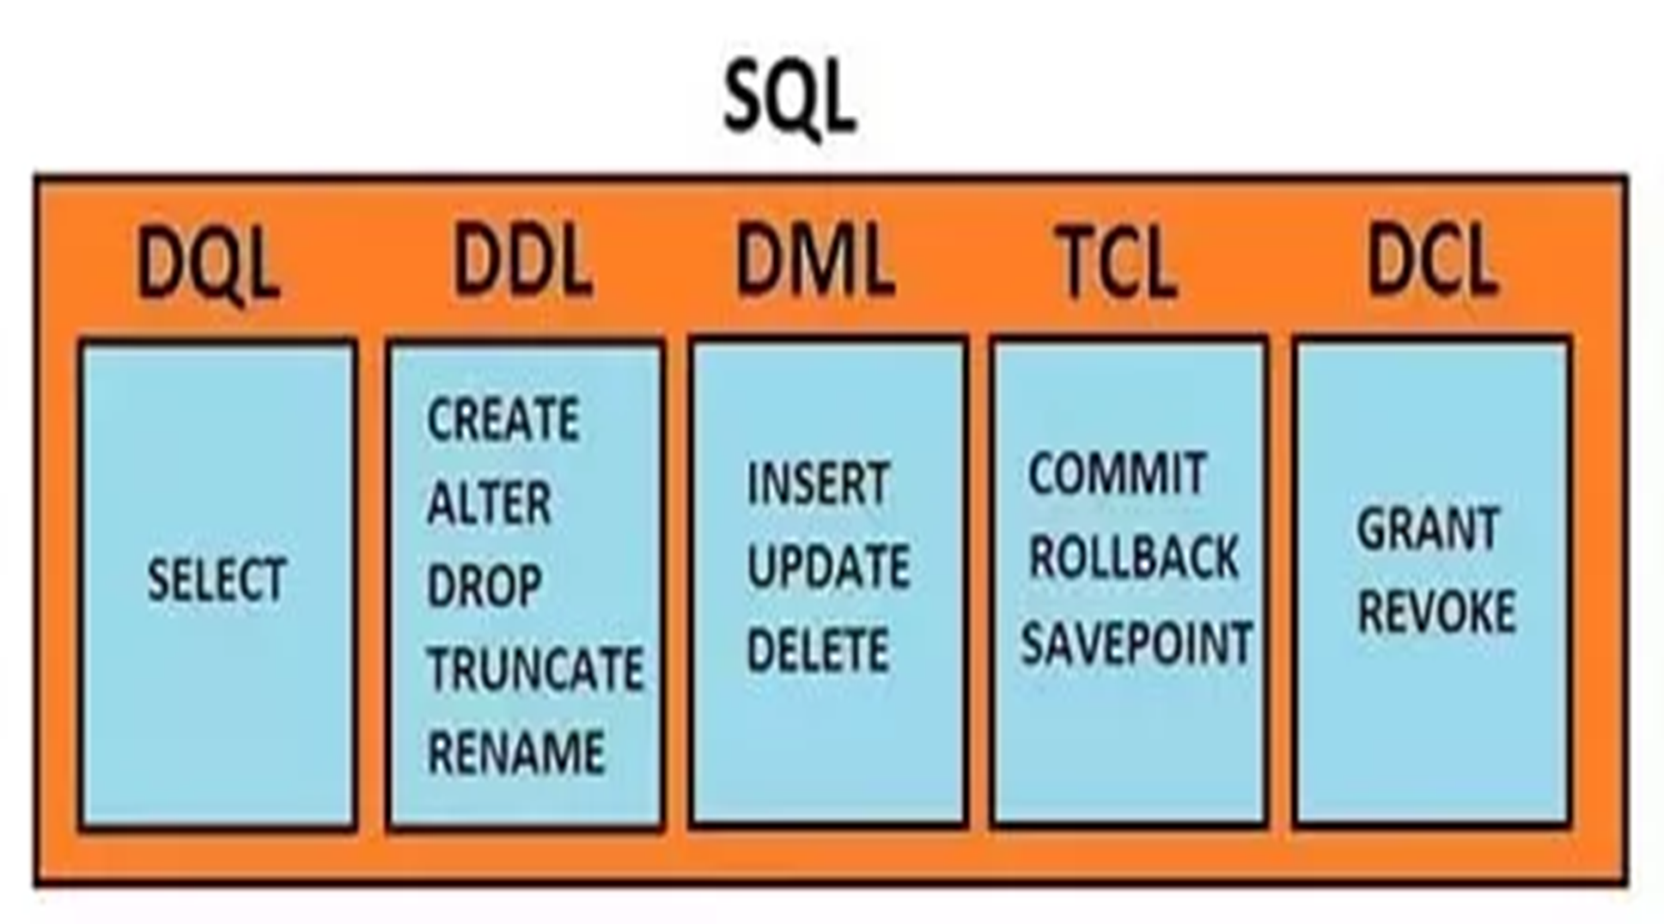
What is a database
Database is a organized collection of data. For example a database of a college would be having a collection of data such as – 1. Personal records of Students 2. Students performance history 3. Teachers data 4. Financial department data etc.

Slide 7
DQL
(DATA QUERY LANGUAGE)

Slide 8
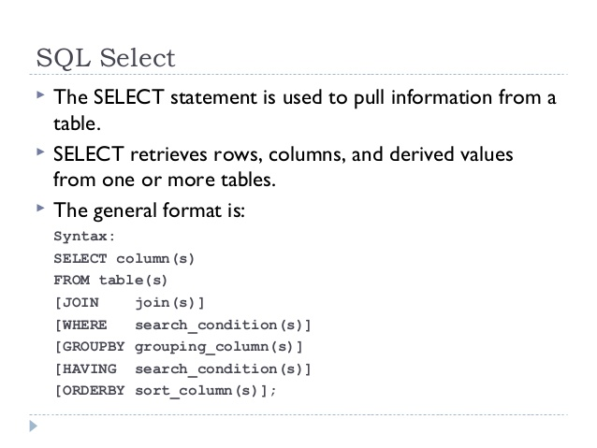

Slide 9
DDL
(DATA DEFINITION LANGUAGE)

Slide 10
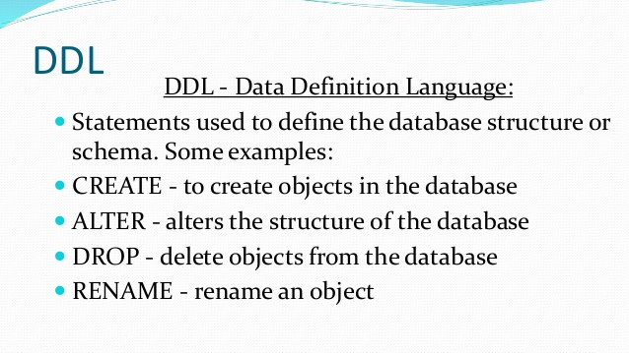

Slide 11
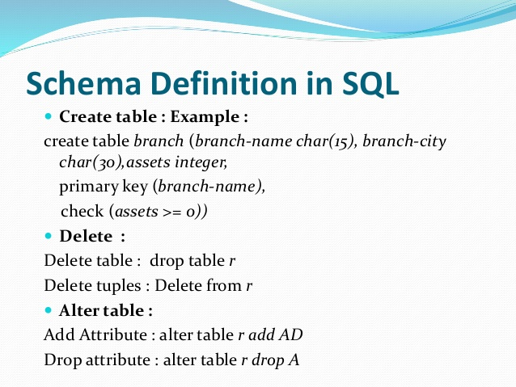

Slide 12
DML
(DATA MANIPULATION LANGUAGE)

Slide 13
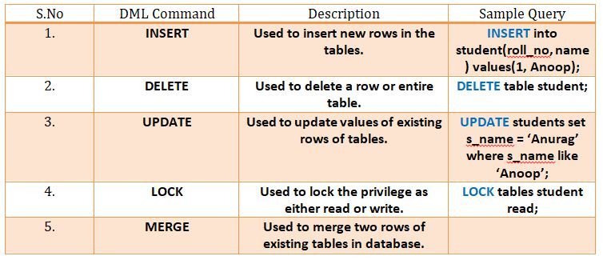

Slide 14
TCL
(TRANSACTION CONTROL LANGUAGE)

Slide 15
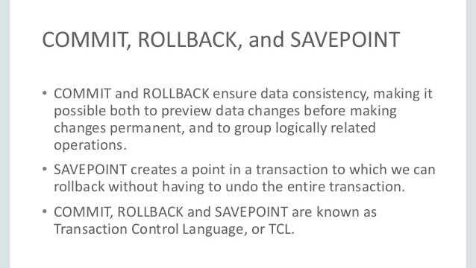

Slide 16
DCL
(DATA CONTROL LANGUAGE)

Slide 17
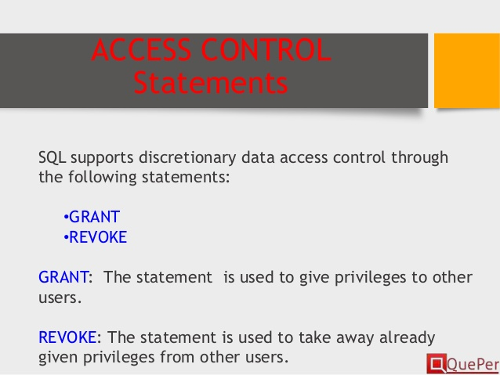

Slide 18
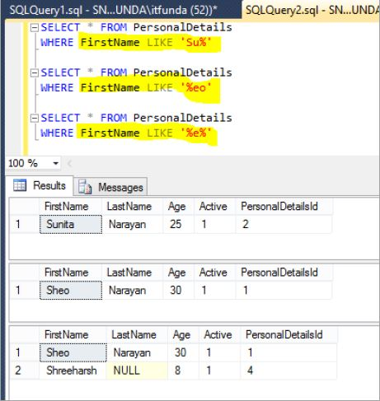

Slide 19
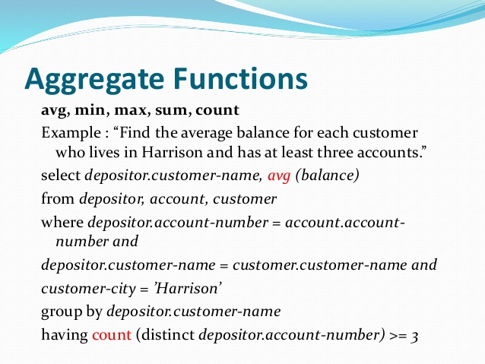

Slide 20
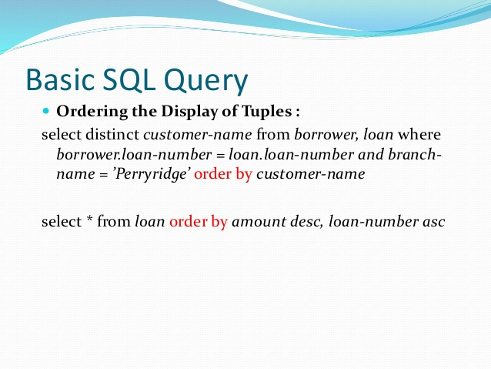

Slide 21
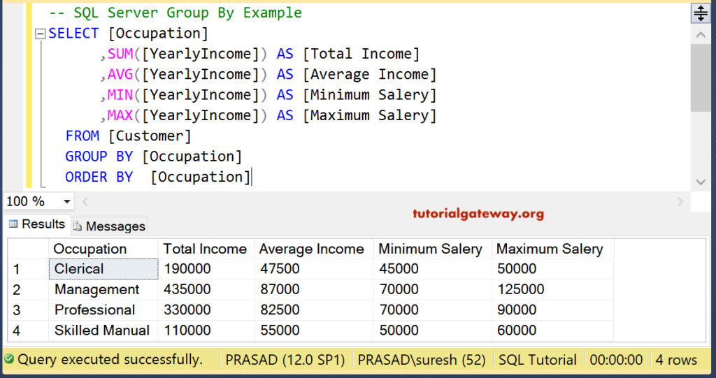

Slide 22
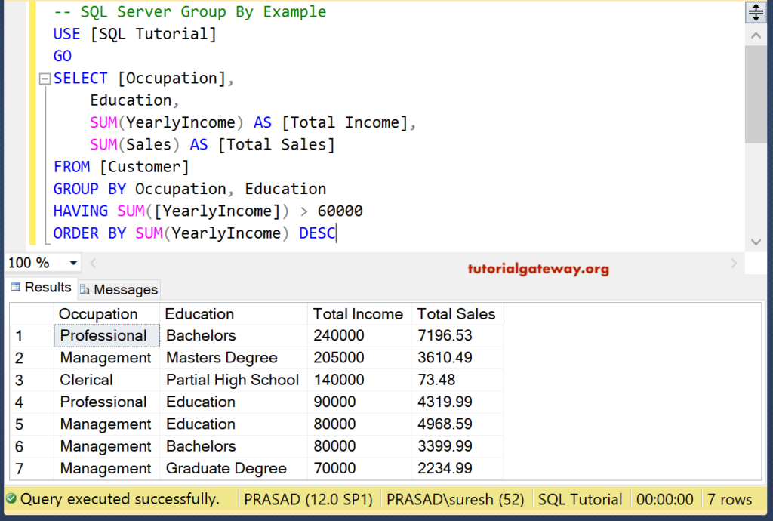

Slide 23
JOINS

Slide 24
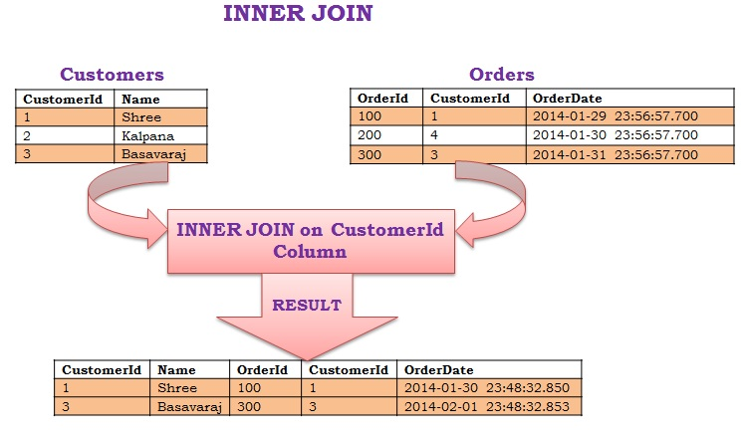

Slide 25
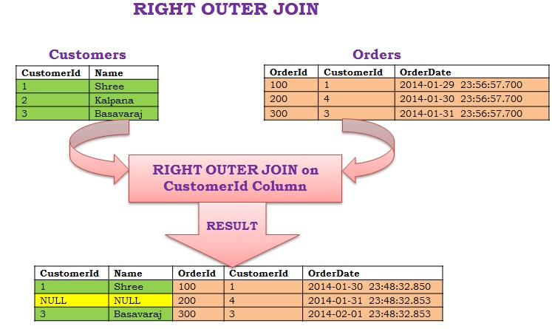

Slide 26
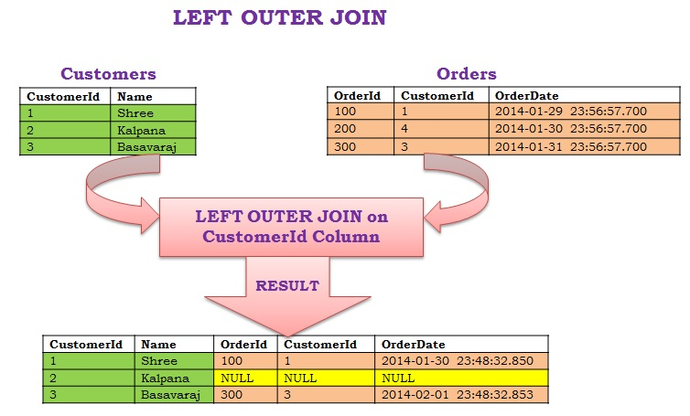

Slide 27
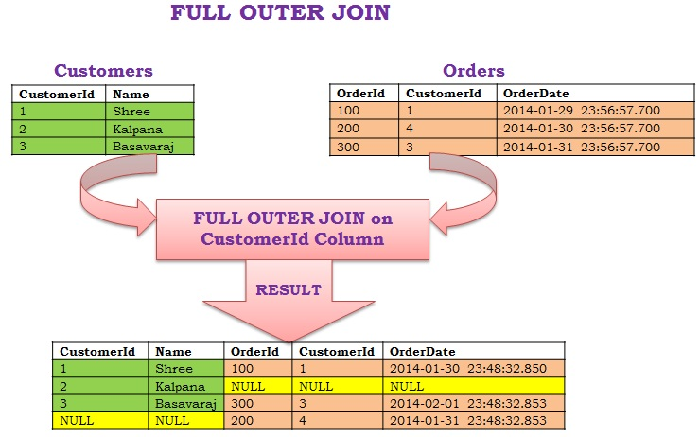

Slide 28
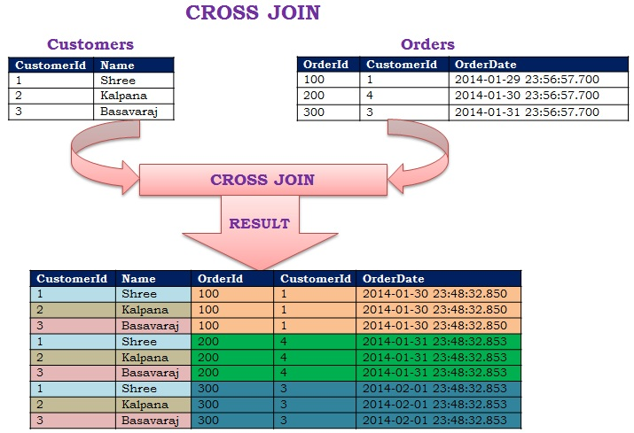

Slide 29
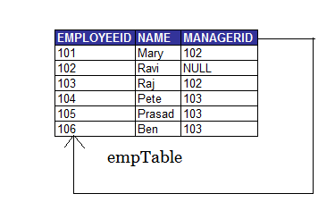
SELF JOIN

Slide 30
Conclusion
One limitation of SQL is that relations must have a fixed set of columns
We came to know about commands used in SQL
SQL is also used to control access restrictions to the database or to parts of it

Slide 31


Slide 32


